Slide 1
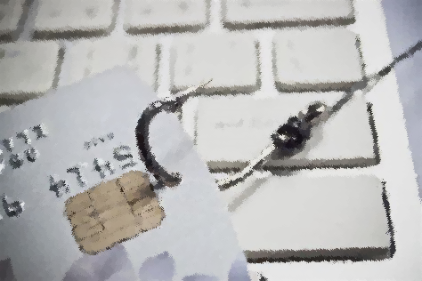
Phishing Awareness Training
Task 3 in CodeAlpha’s cybersecurity training

Slide 2
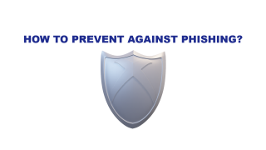
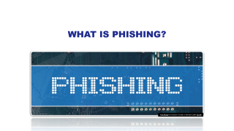
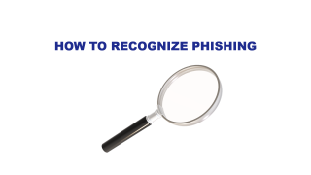
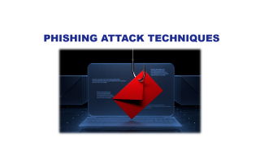
Outlines
(Slides zoom)
Introduction
Recognition
Techniques
Recognition

Slide 3
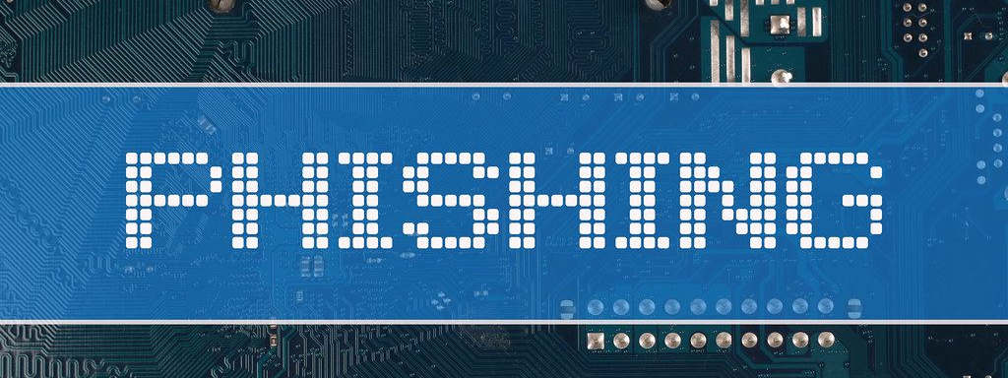
What is phishing?
This Photo by Unknown Author is licensed under CC BY

Slide 4
What is phishing?
Phishing is a scam in which an attacker pretends to be a trustworthy person or organization to steal credentials or sensitive information.
While email is the most common method used in phishing attacks, depending on the specific type of scam, the attacker may also use text messages or voice messages.

Slide 5

How do Phishing Attacks Work?
A typical phishing attack involves sending mass emails to entice recipients to click on malicious links.
Threat actors, whether criminals or nation-states, design these emails to appear legitimate, often mimicking banks, employers, or government agencies to extract information.
The intent may be to deploy ransomware, steal credentials, open fraudulent accounts, or compromise endpoints. A single click on a malicious link can cause significant problems.

Slide 6
Some Extra Statistics
Here’s how often some of the most common phishing techniques were deployed in 2023, according to a report by Cloudflare Inc. :
Malicious link: 35.6%
identity deception: 14.2%
credential harvester: 5.9%
brand impersonation: 5.4% (Microsoft was the most impersonated brand)
malicious attachment: 1.9%

Slide 7
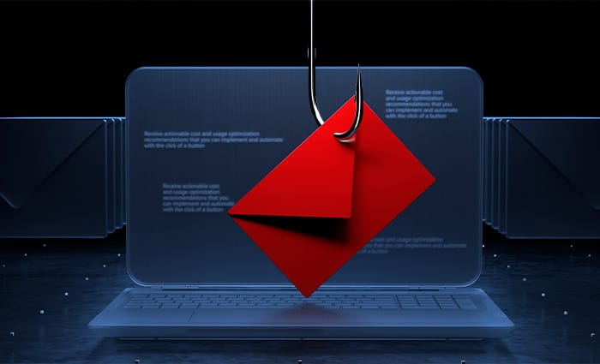
Phishing Attack Techniques

Slide 8

Phishing Attack Techniques
Email Phishing :
Spear phishing
A phishing attempt that targets a specific individual or group of individuals. Victims may be targeted to reach a more valuable target; for example, executives with greater access to sensitive information. Those higher-level executives may be targeted in the next phase of the attack.
Whale Phishing (Whaling)
Whaling is a type of spear-phishing that targets a high-profile victim, such as a CEO or CFO. Whaling attacks usually employ a sense of urgency to pressure the victim into wiring funds or sharing credentials on a malicious website.

Slide 9

Phishing Attack Techniques
Voice Phishing (Vishing) :
A phishing attack conducted by telephone. These attacks may use a fake Caller ID profile to impersonate a legitimate business, government agency or charitable organization. The purpose of the call is to steal personal information, such as bank account or credit card numbers.

Slide 10

Phishing Attack Techniques
SMS Phishing (Smishing) :
A phishing campaign conducted through SMS messages instead of email. Smishing attacks are unlikely to result in a virus being downloaded directly. Instead, they usually lure the user into visiting a site that entices them to download malicious apps or content.

Slide 11

Phishing Attack Techniques
Angler Phishing :
Targets Social Media Users. Bad Actors will direct message disgruntled customers, pretending to be customer service agents, to obtain personal information or other account credentials

Slide 12

How to Recognize Phishing

Slide 13

How to Recognize Phishing?
Typical characteristics of phishing messages make them easy to recognize:
Asks for Sensitive Information
Uses a Different Domain
Contains Links that Don’t Match the Domain
Includes Unsolicited Attachments
Is Not Personalized
Uses Poor Spelling and Grammar
Tries to Panic the Recipient

Slide 14

How To Prevent Against Phishing?

Slide 15

How To Prevent Against Phishing?
Never reply to spam: Responding to phishing emails signals that your address is active, putting you at higher risk for future attacks.
Use anti-virus software: Deploy anti-malware tools to scan devices for malware from phishing attacks.
Use an anti-spam filter: Implement filters that use blacklists to move phishing emails to the junk folder, reducing human error.
Use up-to-date browser and software: Always use the latest versions of browsers and software to benefit from the latest security updates against phishing scams.

Slide 16

How To Prevent Against Phishing?
Use multi-factor authentication (MFA): Even if credentials are compromised, MFA adds a second layer of verification, such as a phone access code, before allowing access to sensitive accounts.
Don’t open the email: If you suspect a phishing email, do not open it; instead, report it through the appropriate channels.
Employee awareness training: Train employees to recognize and report phishing attempts to corporate security staff.

Slide 17
Thank You For Your Time
By : Salma Hisham Wagdy

